Slide 1
BASICS OF C++

Slide 2
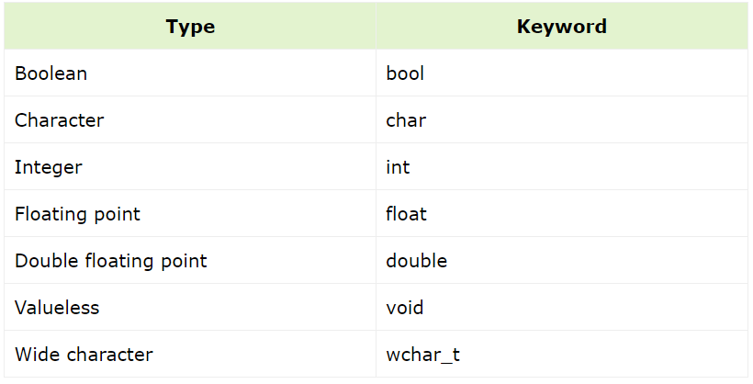
DATATYPES
Combine the types with these if need be
signed
unsigned
short
long
(true or false)

Slide 3
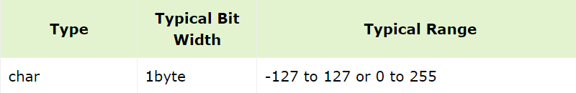
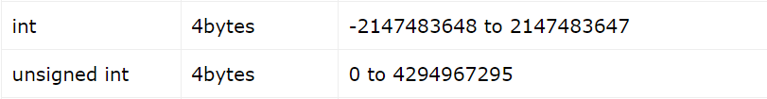
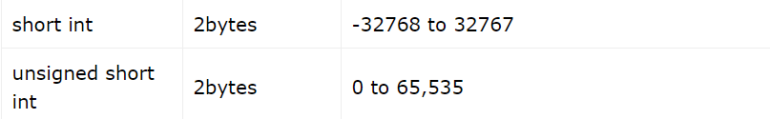
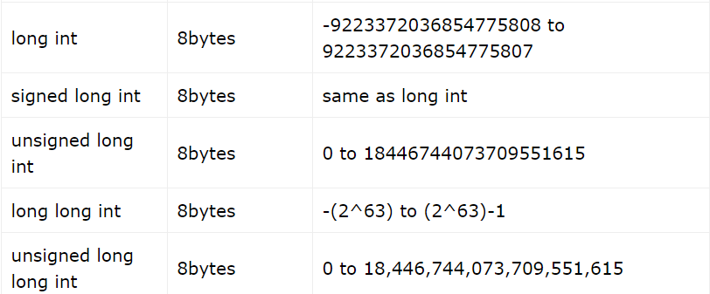
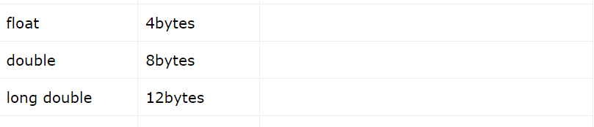

Slide 4
DECISION MAKING AND BRANCHING
if statement
switch statement
ITERATIVE AND LOOPING STATEMENTS
for
while
do-while
for-each

Slide 5
void decision()
{
int a,b,c,max;
cout << "Enter the numbers: " << endl;
cin >> a >> b >> c;
if(a > b)
{
if(a > c) max = a;
else max = c;
}
else
{
if(b > c) max = b;
else max = c;
}
cout << max << endl;
}

Slide 6
void switchCase()
{
int ch;
cout << "Enter the choice: " << endl;
cin >> ch;
switch(ch)
{
case 1:
cout << "1 is selected" << endl;
break;
case 2:
cout << "2 is selected" << endl;
break;
default:
cout << "Neither were selected" << endl;
}
}

Slide 7
void loops()
{
int arr[5];
//for loop
for(int i = 0; i < 5; i++)
{
arr[i] = i;
}
cout << endl;
int i = 0;
//while loop
while(i < 5)
{
cout << i << " ";
i++;
}
cout << endl;
//do while loop
do
{
cout << i << " ";
i--;
} while (i > 0);
cout << endl;
//for each loop
for(int a: arr)
{
cout << a << " ";
}
}

Slide 8
String Functions
length(): - Returns the length of the string
find(): - Returns the position of the first occurrence of a substring in a string.
rfind(): - Returns the position of the last occurrence of a substring in a string.
replace(): - Replaces all occurrences of a substring with another substring in a string.
erase(): - Erases a specified number of characters from a string, starting at a specified position.
insert(): - Inserts a specified number of characters into a string, starting at a specified position.

Slide 9

void strings()
{
string s = "hello";
for(int i = 0; i < s.length(); i++)
{
s[i]++;
}
cout << s << endl;
s = "say";
s.pop_back();
s.push_back('t');
cout << s << endl;
for(auto a = s.rbegin(); a < s.rend(); a++)
{
cout << *a;
}

Slide 10





reverse(s.begin(), s.end());
cout << endl;
cout << s;
cout << endl;
s = "the quick brown fox jumped over the lazy dog";
cout << s.find("the") << endl;
cout << s.rfind("the") << endl;
string str1 = "Let us learn C language";
string str2 = "C++";
cout << "The string before replacement is: "<<str1<<'\n';
str1.replace(13,1,str2); //13 => 13th index, 1 => 1 char(s) from 13th (inclusive) replace with str2
cout << "The string after replacement is: "<<str1<<'\n';
}

Slide 11
STL – Standard Template Library

Slide 12
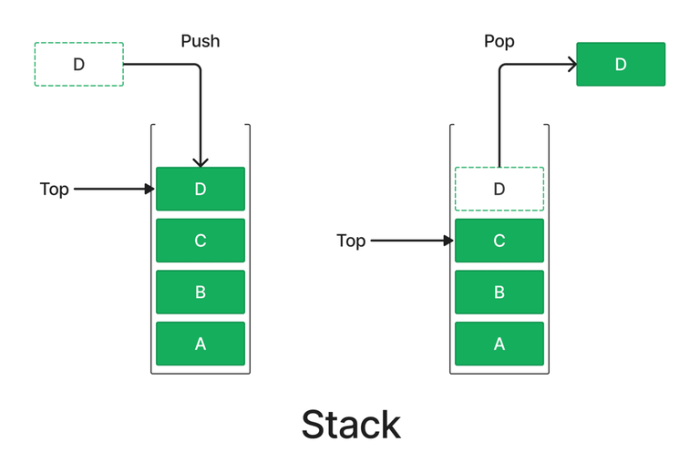
Stack
LIFO – Last In First Out
struct stack
{
int top;
int arr[];
};
void push(int x)
int top()
void pop()

Slide 13
#include <bits/stdc++.h> //Used for STL
void explainStack()
{
stack<int> st;
st.push(1);
st.push(2);
st.push(3);
st.push(4);
st.push(5);
cout << "\n" << st.top() << endl;
st.pop();
//also st.size() and st.empty()
}

Slide 14
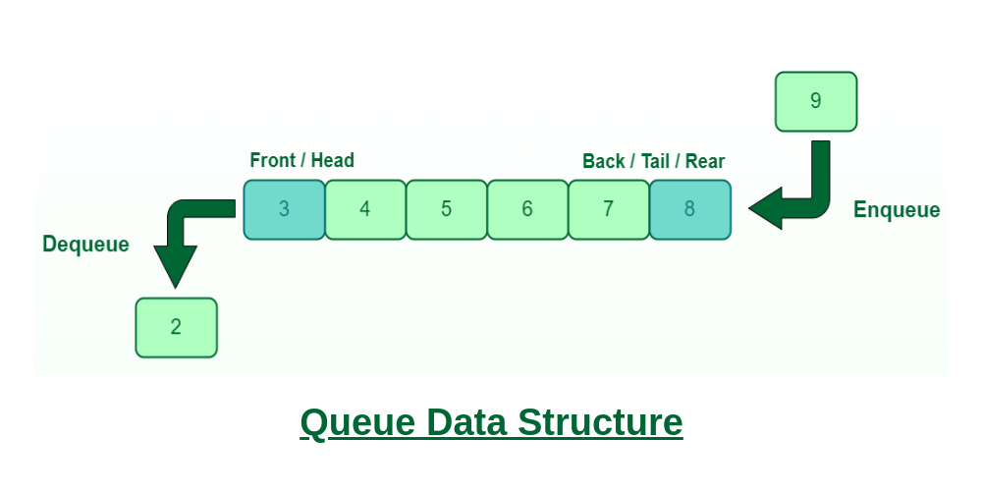
Queue
FIFO – First In First Out
struct queue
{
int front;
int rear;
int arr[];
};
void enqueue(); //used as push
void dequeue(); //uses as pop
int front();
int back();

Slide 15
void explainQueue()
{
queue<int> q;
q.push(1);
q.push(2);
q.push(3);
cout << "Front: " << q.front() << endl;
cout << "Back: " << q.back() << endl;
// q.front() is the first element and q.back() is the last element
q.pop(); // pop the first element because FIFO
cout << "Front: " << q.front() << endl;
cout << "Back: " << q.back() << endl;
}

Slide 16
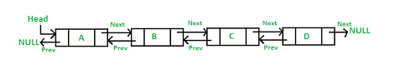
Lists
struct node
{
node* next;
node* prev;
int val;
};
struct list
{
node* head;
int size;
};

Slide 17
void explainList()
{
list<int> ls = {1,2,3,4,5};
ls.push_back(6); //or emplace
ls.push_front(0); //or emplace
cout << endl; //doubly linked list to reduced time complexity when compared to insert in vector
for(int i : ls)
cout << i;
cout << endl;
cout << "Front: " << ls.front() << "\nBack: " << ls.back() << endl;
//rest similar to vectors
}

Slide 18
Vectors
Iterators:
begin(), end(), rbegin(), rend()
Attributes:
size(),front(),back(), []/at()
Modifiers:
push_back(), pop_back(), insert(), erase()

Slide 19
void vec()
{
vector<int> v;
v.push_back(1);
v.push_back(2);
v.push_back(3);
vector<int>::iterator itn = v.end();
cout << *(itn-1) << endl;
vector<int>::reverse_iterator it = v.rbegin();
cout << *(it) << endl;
for(int i: v)
{
cout << i;
}
cout << endl;
for(vector<int>::reverse_iterator i = v.rbegin(); i < v.rend(); i++)
{
cout << *i;
}

Slide 20
cout << endl;
for(int i = 0; i < v.size(); i++)
cout << v[i];
cout << endl;
auto i = find(v.begin(), v.end(), 2);
cout << i-v.begin();
cout << "\n" << endl;
vector<int> v2(10,5);
for(auto i: v2) cout << i;
vector<int> v3 = {6,4,2,7,3,1,6,4,0};
sort(v3.begin(),v3.end(),greater<int>());
cout << endl;
for(auto i: v3) cout << i;
cout << endl;
v3.insert(v3.begin()+4,9);
for(auto i: v3) cout << i;
v3.erase(v3.begin()+2,v3.end()-1);
cout << endl;
for(auto i: v3) cout << i;
}

Slide 21
Common Algorithms
sort(first_iterator, last_iterator, *, function[if need be]) – Ascending
sort(first_iterator, last_iterator, greater<int>()) - Descending
find(first_iterator, last_iterator, value) – Iterator to first position
reverse(first_iterator, last_iterator) – Reverse
*max_element (first_iterator, last_iterator) – Max Element
*min_element (first_iterator, last_iterator) – Min Element
count(first_iterator, last_iterator,value) – Count occurances of value

